Slide 2
DEVLOLOPS
MATT STRATTON, 4/2/2015

Slide 3
MATT STRATTON
SOLUTIONS ARCHITECT, CHEF SOFTWARE, INC
@mattstratton

Slide 4
DEVOPS IS ABOUT PEOPLE
Tools are awesome, but DevOps is about communication.
Words are hard. Reading takes time.
Velocity is key in all of DevOps, even in communication.

Slide 5
WHICH IS CLEARER?
Sean: Whoa, I just accidentally rebased the entire git repo.
Matt: That wasn’t a very good decision, Sean. You should really consider the ramifications of your decision next time.

Slide 6
MUCH BETTER
Sean: Whoa, I just accidentally rebased the entire git repo.
Matt:

Slide 7
THE SCIENCE OF DEVLOLOPS

Slide 8
AUTOMATION IS KEY
Timing is everything in comedy.
Velocity matters for delivering your product, but it’s even more important with your GIF’s.
This is especially important in real-time communication (Hipchat, Slack, etc)
Do you really want to slow down your delivery pipeline because you are too slow with a GIF?

Slide 9
MANUAL WORKFLOW
Someone says something you want to react to.
You open http://images.google.com and search for the appropriate GIF.
You paste the URL of the GIF into the chat room.
By the time this happens, ten more messages have gone past and nobody knows what you are talking about anymore.

Slide 10
Sean: My feature didn’t pass integration testing
Galen: That’s unfortunate.
Yvo: Reminder: Submit all your expense reports, folks!
Bakh: OK boss.
Aimee: Who’s taking care of Customer X?
Matt:
Sean: What are you talking about, Matt??
Yvo: This is going in your performance review.

Slide 11

THE SECRET IS TEXT EXPANSION
You need to have an arsenal of GIF’s that you can call up at a moment’s notice with a simple keyboard shortcut.
The tool I prefer (which is an OS X only tool) is TextExpander.
There will be a link for download and a discount code at the end of this deck.

Slide 12
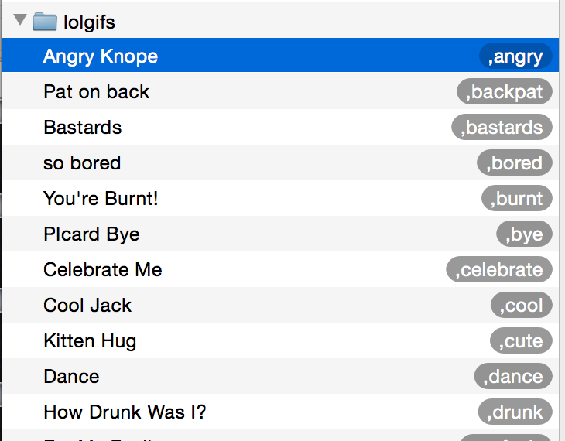
ORGANIZE YOUR FUNNY
Use a separate folder in Text Expander just for your GIF’s
Make sure that they have easy to remember shortcuts
Descriptive names help too

Slide 13
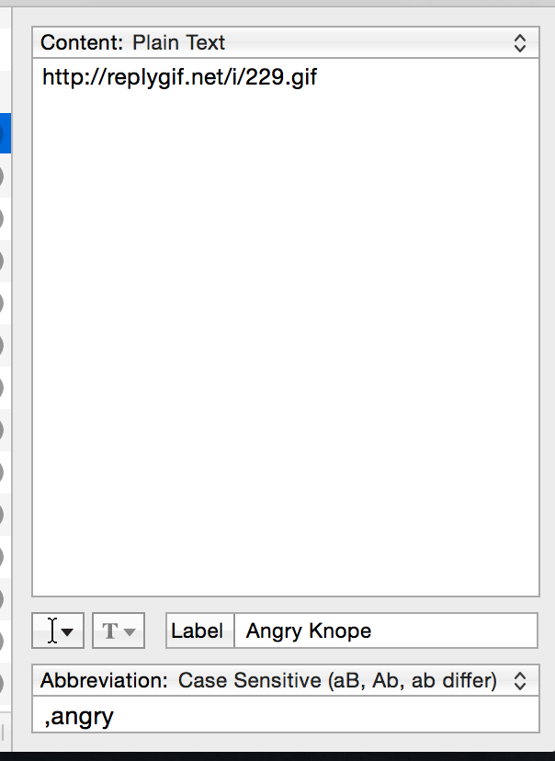
ORGANIZE YOUR FUNNY
One trick I like to use is to prepend a comma with no space to the shortcut.
Unless you are a really bad typer, this won’t be a problem for you.
The expansion turns ,angry into http://replygif.net/i/229.gif

Slide 14
RESEARCH AHEAD OF TIME
Don’t wait until you need a GIF to find it.
Think of responses you tend to need, and preload your text expansion tool with the shortcuts.
Practice your GIF-fu with a private Hipchat channel so that you don’t have to keep going back to your text expansion list to remember your shortcuts.

Slide 15
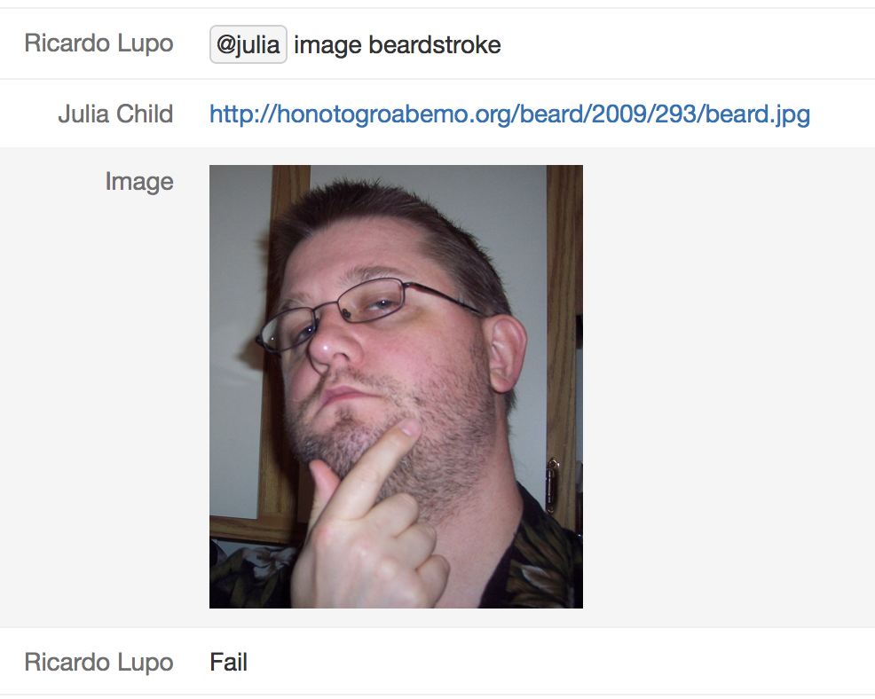
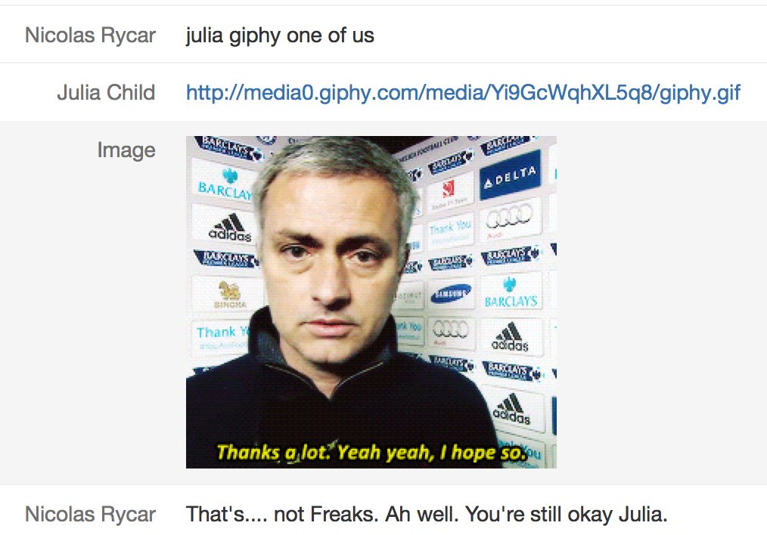
TOO MUCH AUTOMATION IS LAZY
Notes:
Trusting external tools makes communication less clear, rather than more. You are trying to actually use your own ideas, not some random internet search. Curate your gif’s

Slide 16
PRO TIPS
Think outside the box. Search for obscure animated GIF’s. Picard facepalms are for amateurs.
Set up a #gifparty channel in your Hipchat for co-workers to randomly share their favorites. Then totally steal them.
Include “animated GIF” in your Google Images searches.
replygif.net is a treasure trove. Shout-out to Fletcher Nichol for sharing that one with me.
Consider your audience. Funny is not more important than safe spaces.

Slide 17
TOOLS
TextExpander - http://bit.ly/smile-chefconf Discount code CHEF201504MST for 20% off
Matt’s git repo - https://github.com/mattstratton/devlolops
GIF keyboard for iOS and Android - https://www.riffsy.com/

